Slide 1

How SDR Works
And How the Pi‑Pico SDR Pulls It Off
Tayloe Detector → Baseband → DSP → Audio
Notes:
The essentials of how the Pi‑Pico SDR works — the Tayloe detector, how we get baseband, and what the Pico does to turn RF into audio.

Slide 2
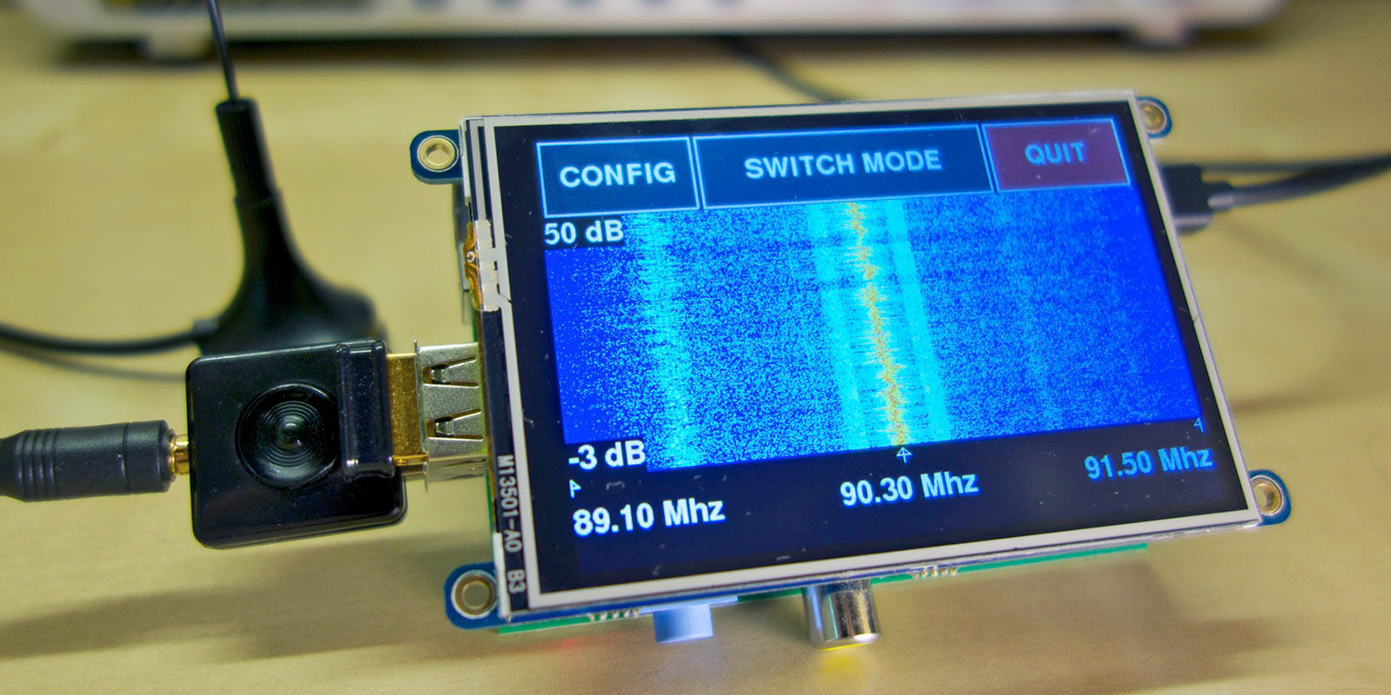
Understanding SDR
The Pi‑Pico HF Receiver & the Tayloe Detector

Slide 3
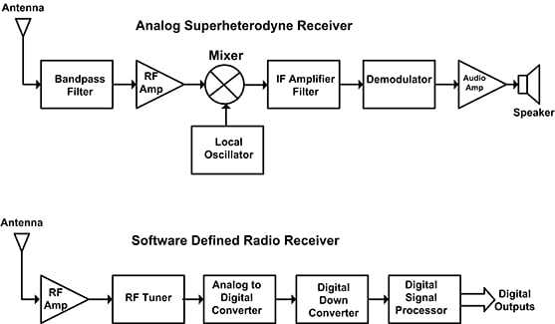
What Is SDR?
Software‑Defined Radio = radio where software does the heavy lifting.
Traditional radio:
RF → mixer → IF filters → detector → audio
SDR:
RF → simple front‑end → ADC → software → audio
Notes:
SDR moves complexity from hardware into software. That’s why this design is so simple.

Slide 4
How and Why is an SDR possible as a club project?
Three enablers:
Fast microcontrollers
Cheap, accurate ADCs
Simple RF front‑ends (like the Tayloe detector)

Slide 5
The SEMARC Pi‑Pico SDR in One Sentence!
A Tayloe detector produces I/Q baseband,
the Pico digitises it, and software turns it into audio.
Notes:
the whole design in one line. Everything else is detail.

Slide 6
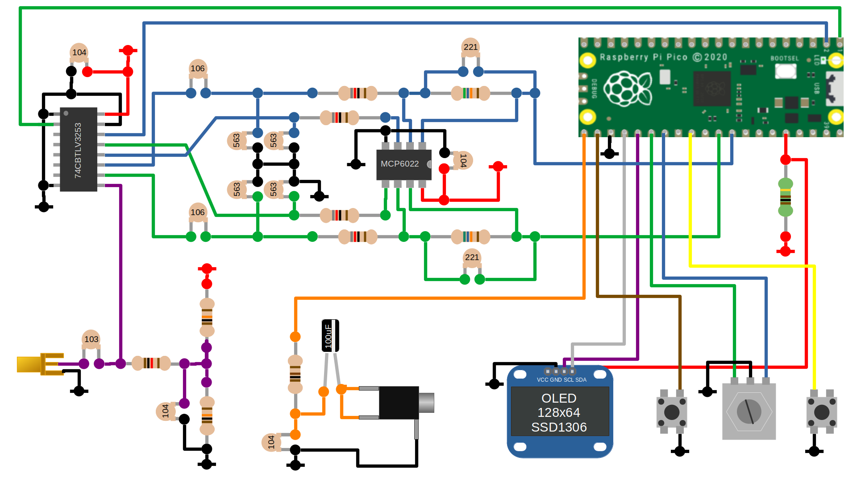



System Pictorial Diagram
Antenna → Tayloe Detector → Op‑Amp → Pico ADC → DSP → Audio

Slide 7
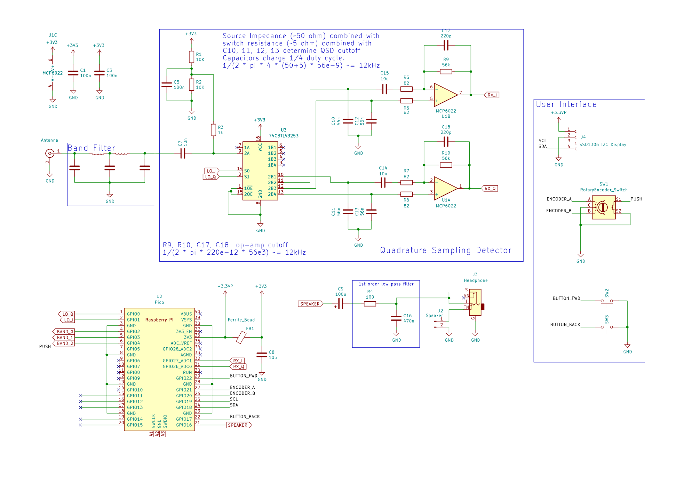
Schematics

Slide 8
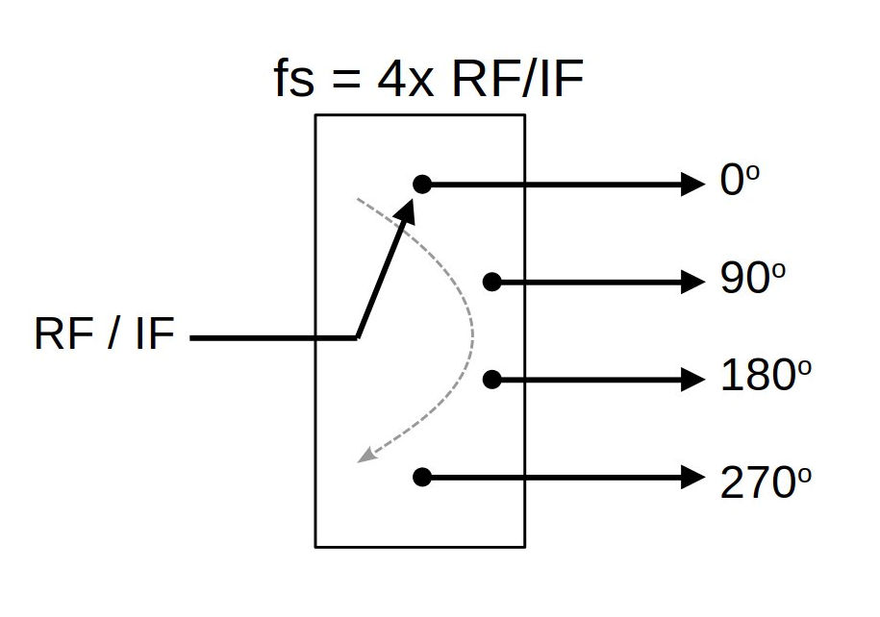
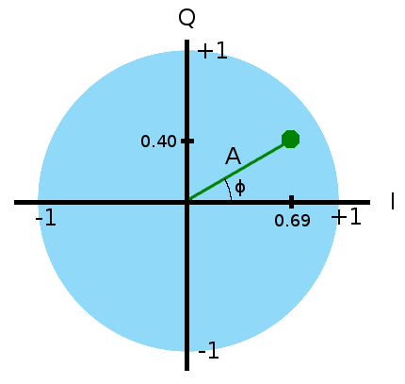
What Is a Tayloe Detector?
A Tayloe detector (Quadrature Sampling Detector):
A switching mixer
• Uses a 4‑way analogue switch (74CBTLV3253)
• Driven at 4× the receive frequency
• Samples RF at 0°, 90°, 180°, 270°
• Opposing samples → I and Q
Notes:
The Tayloe detector is elegant, low‑noise, and perfect for HF.

Slide 9
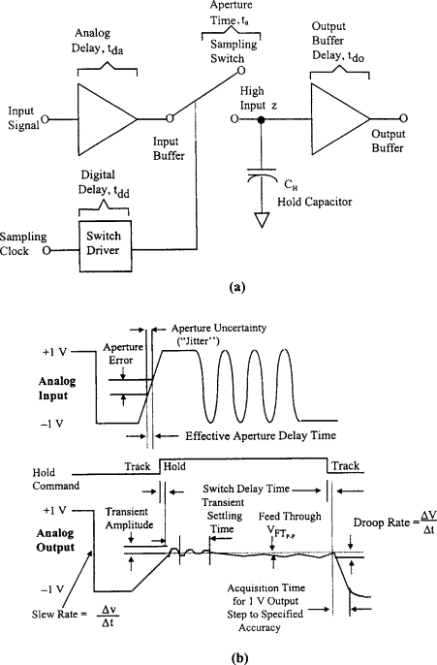
The Capacitors: Where Baseband Comes From
They hold each sample long enough to turn RF into audio.
Key points:
Each capacitor charges to the RF voltage at its sampling moment
Between samples it holds that voltage
The held voltage varies slowly with the modulation
That slow variation is the baseband
Opposing capacitors → I and Q
Notes:
This is the heart of the detector. The capacitors turn fast RF into slow audio‑range signals.

Slide 10
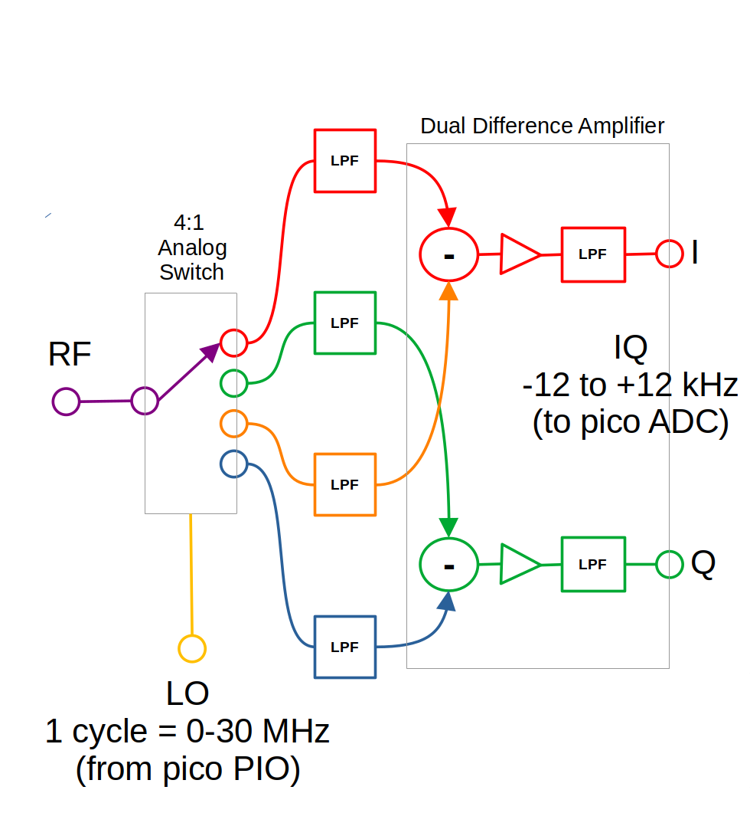
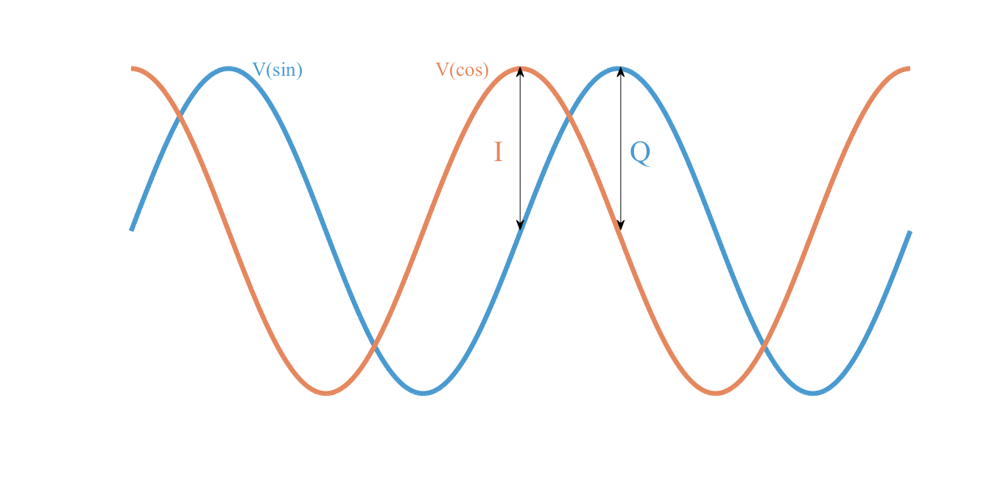
Why I/Q Matters
I/Q gives software everything it needs.
Key points:
Separate sidebands
Demodulate AM, SSB, CW, FM
Apply digital filters
Tune smoothly
Display a spectrum
Notes:
I/Q is the foundation of modern SDR. Without it, you can’t do SSB cleanly.

Slide 11
What the Pico Does (1): LO + ADC
The Pico generates the LO and digitises I/Q.
Key points:
PIO generates a stable square‑wave LO (4× RF)
ADC samples I and Q at ~500 kS/s
Produces digital I/Q streams
Notes:
Once the signals are digital, everything else is software.

Slide 12
What the Pico Does (2): DSP + Audio
The Pico becomes a complete radio in software.
Key points:
Digital mixing
Filtering
AGC
Demodulation (AM, SSB, CW, FM)
Audio output via PWM
Optional PAM8403 amplifier for speaker or amplified speakers
Notes:
This is the digital equivalent of a superhet receiver — all inside a £4 microcontroller.

Slide 13
Why This SEMARC Project
Simple hardware, powerful software.
Key points:
Very low parts count
Easy to build
Easy to understand
Encourages experimentation – Potential for add ons and a decoder
Real HF performance – can be improved with simple band pass filters
Perfect for a club project – customisable by experimentation
Notes:
This design is simple, elegant, and genuinely capable. It’s the perfect project to bring together everything SEMARC has been doing.

Slide 14
Summary
Tayloe detector samples RF at four phases
Capacitors hold samples → baseband
Opposing samples → I/Q
Op‑amp boosts signals
Pico generates LO, digitises I/Q, runs DSP, outputs audio
Simple hardware, powerful software

